Slide 1
Progress and Future Plans for emCCD Testing
Steve Conard
Dylan Holenstein
Bruce Holenstein
33rd Annual Meeting of the International Occultation Timing Association
16-18 October July 2015
Cheyenne Campus of the College of Southern Nevada
North Las Vegas, Nevada

Slide 2
Agenda
Testing performed this past year
New hardware acquired and access to new facilities
Plans for testing in the coming year

Slide 3
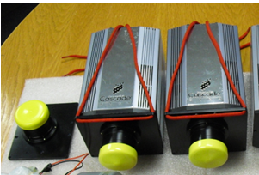
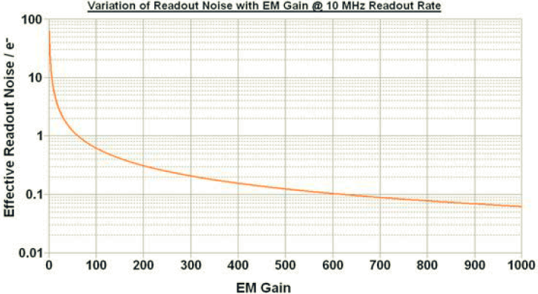
emCCD Cameras
Described in our 2014 IOTA talk: “Specialized Software and Equipment for High Speed Cameras”
Photometrics Cascade 512B emCCD
CCD read noise is reduced from 10’s of electrons per pixel to under 0.1 per pixel. Back illumination increases QE to over 90%.
Notes:
Photometrics Cascade 512B emCCD
16micron pixels, 16 bits, 200k e- wells

Slide 4
2015 Testing to Date
Due to work commitments, only a very limited amount of testing was performed
A few lunar occultations were attempted
Lambda Gemini is the only one we’ll address today
No appropriate asteroid events were tried
On high probability events, we tend to be risk adverse, and avoid losing a potential positive by using traditional equipment
New equipment and access to new facilities should help with this in the coming year

Slide 5
Lambda Gemini
On Feb 28th, the waxing gibbous moon occulted λ-Gemini over North America
This is (quaduple) star, with non-instantaneous transitions reported
Conard used a Photometrics 512B, on a C-14 operating at its native f:11 to attempt to record this event
The camera was windowed at 32 x 32, and binned by 2, in order to achieve a frame rate of 200 Hz
Dylan’s software (PVCAMTest and Bin2ADV) was used to record & convert the data, and Tangra used for the analysis

Slide 6
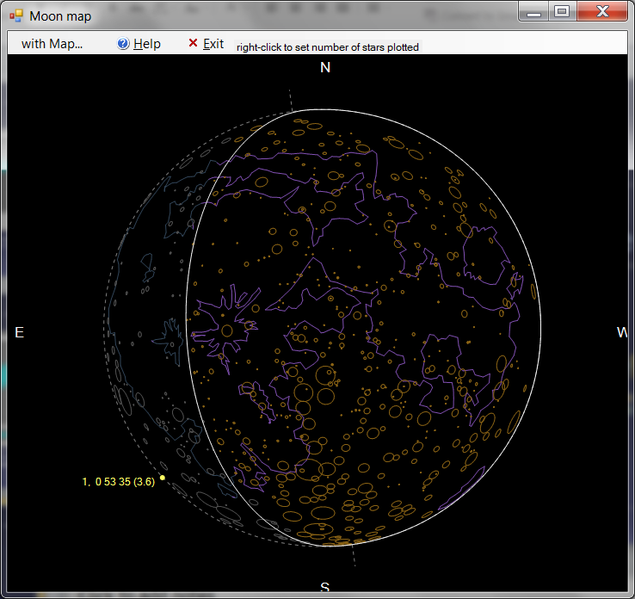
Lambda Gem Moon Map at Willow Oak Observatory

Slide 7
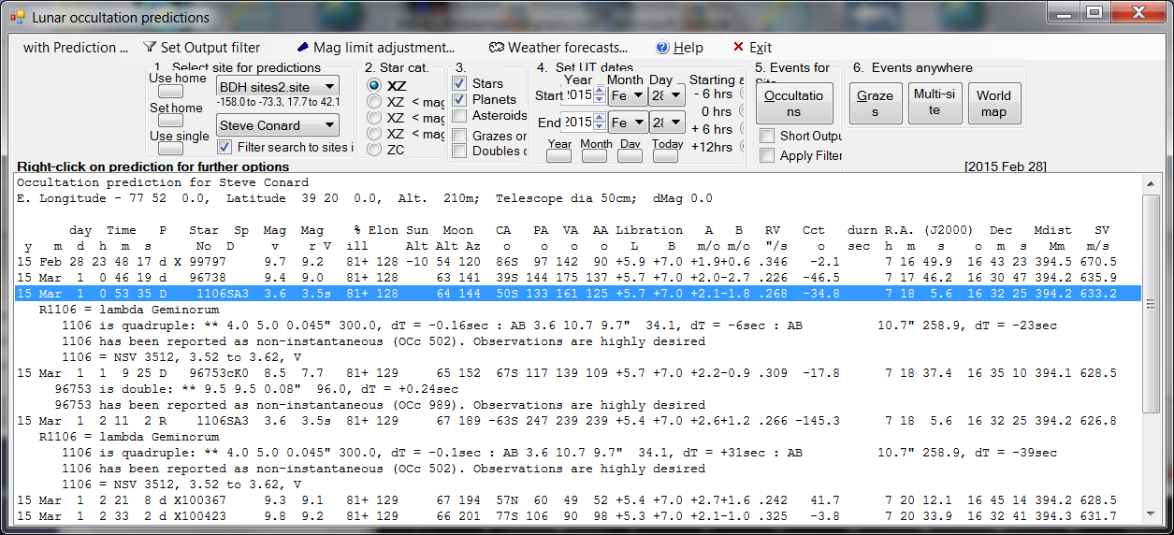
Lambda Gem Occultation at Willow Oak Observatory

Slide 8
Lambda Gem – The System
Right ascension 07h 18m 05.6s
Declination +16° 32′ 25.4″
Apparent magnitude (V) 3.571[2]
Radius 2.7773 ± 0.0469 R☉
Distance 30.9 ± 0.2 pc
Quadruple
Source: Wikipedia

Slide 9
Lambda Gem Video Using Media Player Classic
Notes:
Insert the video here—if possible, leave the left at “actual size” and have a second video at right magnified
Play it one of more times without any pre-discussion

Slide 10
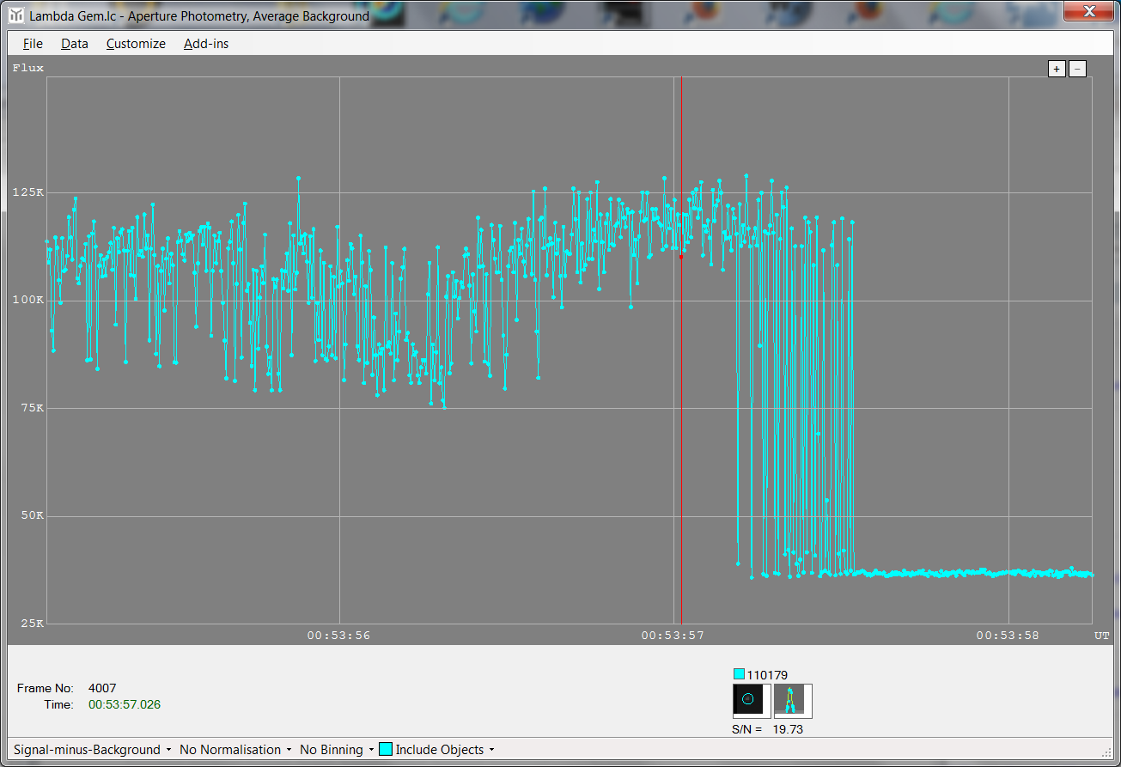
Lambda Gem – Tangra LC

Slide 11
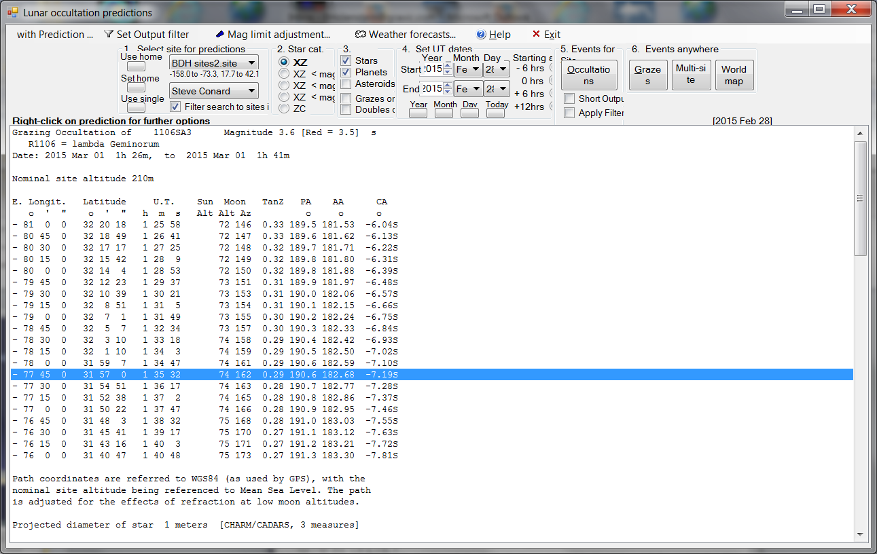
Computed Graze

Slide 12
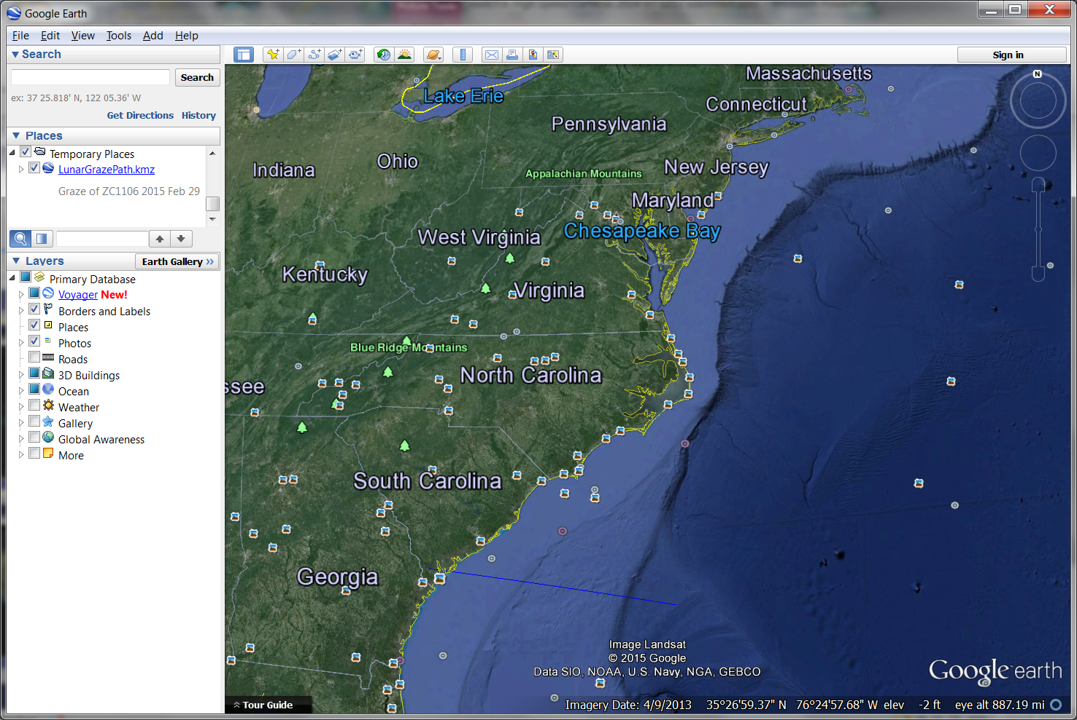
Computed Graze was in Georgia

Slide 13
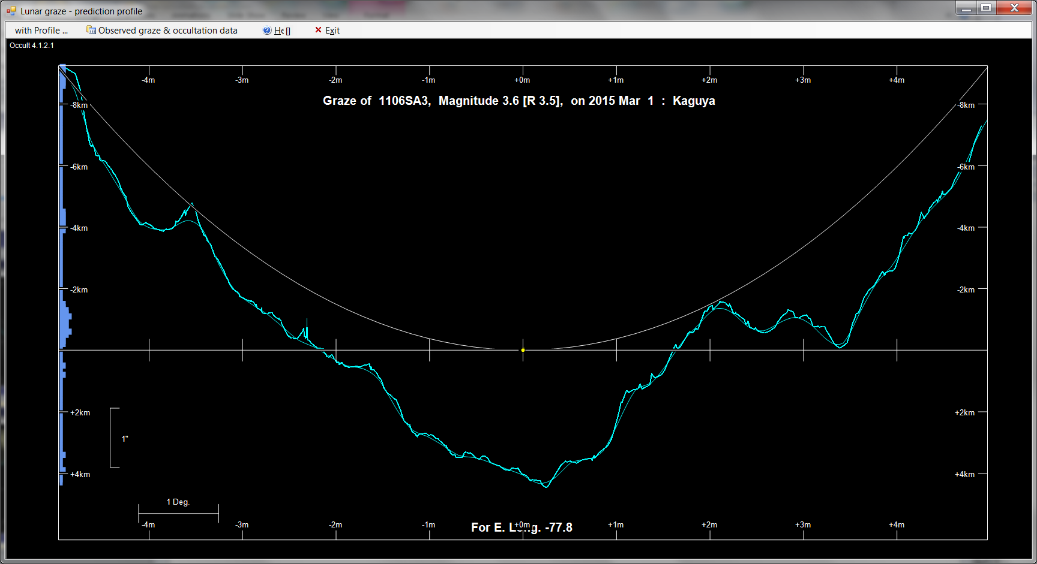

Slide 14
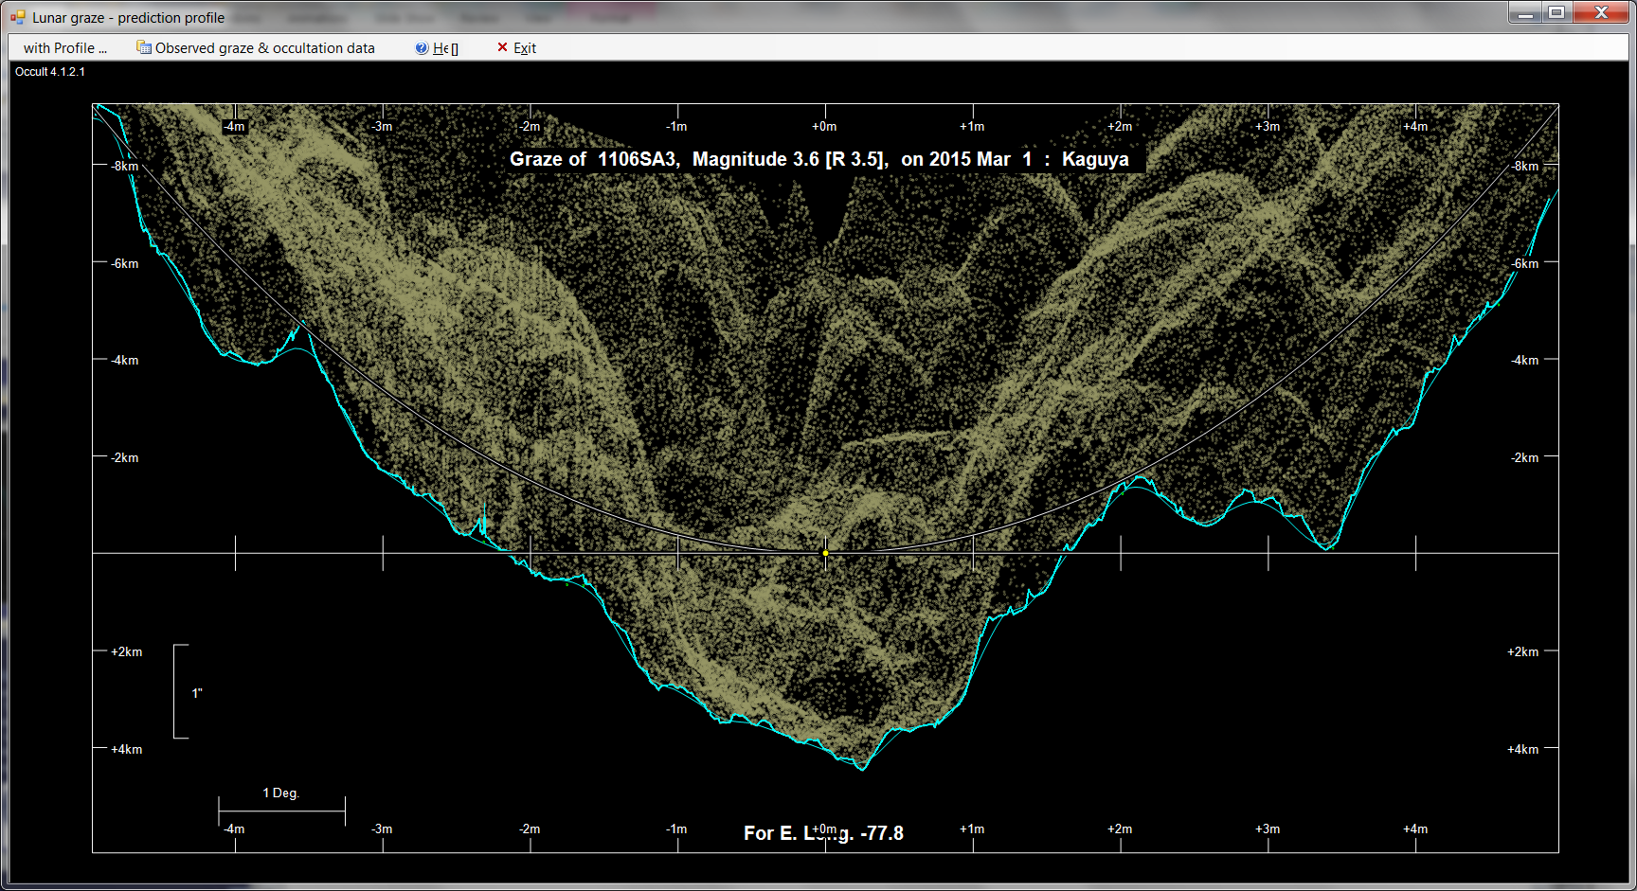

Slide 15
Description
The light curve shows ~13 transitions prior to the star completely disappearing, over a total time of about 0.3 seconds
Equates to about 200 meters on the moon
Most of these are between completely on to completely off, only about 3 partial signal levels
It is exceedingly unlikely that the occultation geometry could support such an event, and the 200 Hz sampling would have to produce many more partial levels than we are seeing
The actual exposure time would have to be a small fraction of the 5 msec cadence to support this result, we believe the duty cycle is about 80%
Our provisional conclusion is that this must be an instrumentally produced result
Notes:
The Star is less than half a meter in diameter at the distance to the moon.

Slide 16
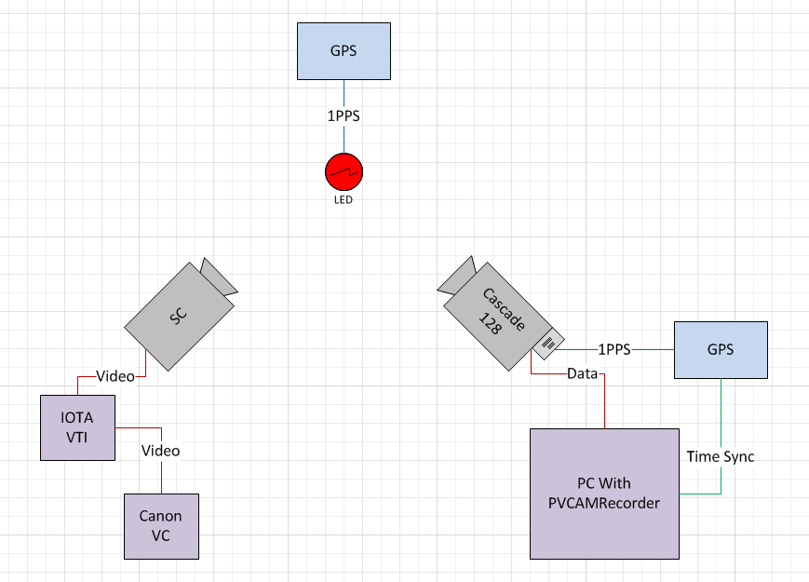
Diagnostic Testing (2014-2015)
164CEX-2 & emCCD capturing LED blinking with 1pps GPS signal,

Slide 17
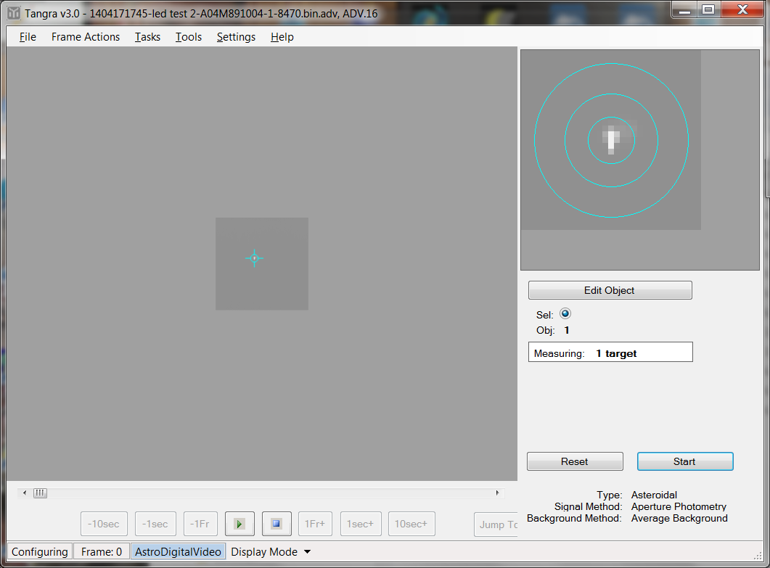
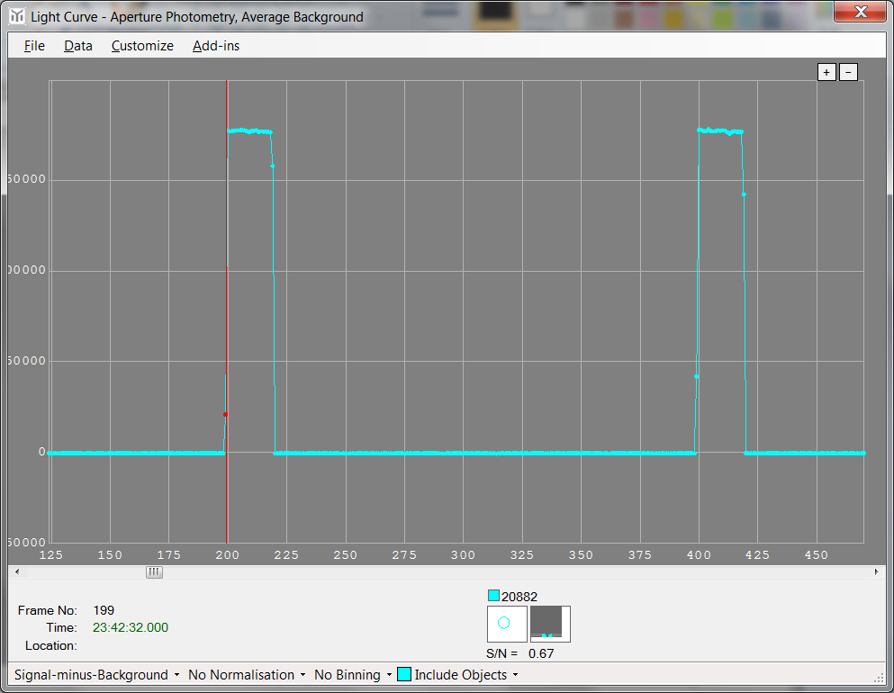
Verification – New Capture Software
Photometrics Cascade 128 emCCD capturing LED blinking with 1pps GPS signal at 200fps, Tangra light curve with timings also captured.

Slide 18
New Equipment
Two Innovation Foresight ONAG-XT’s have been acquired, with adjustable focal reducers
These are designed for “On Axis Guiding”, and contain a dichroic beam splitter
Passes >780 nm (induces slight astigmatism in this leg)
Reflects 350 to 750 nm
We have one here for you to look at, and we hope to use it on tonight’s asteroid event

Slide 19
New Equipment - ONAGs
We intend to use these in two ways
To begin to look for wavelength dependence in the fast-frame rate data collected
To allow us to directly compare timing data collected with traditional RS-170 sensors to the emCCDs, without adding significant risk of data loss for high probability events

Slide 20
New Equipment-AS212 Camera
We have also acquired a ZW Optical ASI224MC camera for testing
This is in response to Russ Genet’s request that we test one for Lunar Occultation work
These are very low noise color CMOS sensors, 1/3” format, USB 3.0 (0.75 to 1.5 e read noise)
Rolling shutter
Small and lightweight
Interestingly, they have very good sensitivity in the NIR, well matched to the ONAG transmitted path

Slide 21
Access to Existing Hardware/Facilities
Conard is observatory director for the new Roelke Observatory near Westminster, MD
This has a 14” SCT on a heavier mount than Conard’s own Willow Oak Observatory, and should allow heavier payloads
Conard likely will soon have access to a 0.6 m R-C at his place of employment
We are trying to obtain access to a 0.8 m R-C at a Baltimore area university as well
All these potential assets should allow us to test these heavy cameras on relatively larger apertures
Continue to look to try faint TNO events

Slide 22
Plans for the Next Year
Begin regularly performing dual camera measurements on both lunar and asteroid events
Some of these will include the ZWO camera
Use high speed cameras to look for diffraction phenomena
Use the emCCDs on larger university-based for very faint events
Actual TNO events or very faint asteroid events

Slide 23
Contact information
Email:
Steve Conard: steve.conard@comcast.net
Dylan Holenstein: d2holenstein@gravic.com
Bruce Holenstein: bholenstein@gravic.com

